Slide 1



SPORT EDA
View in Power BI
Last data refresh:
13/05/2021 08:26:28 UTC
Downloaded at:
13/05/2021 09:56:23 UTC

Slide 2
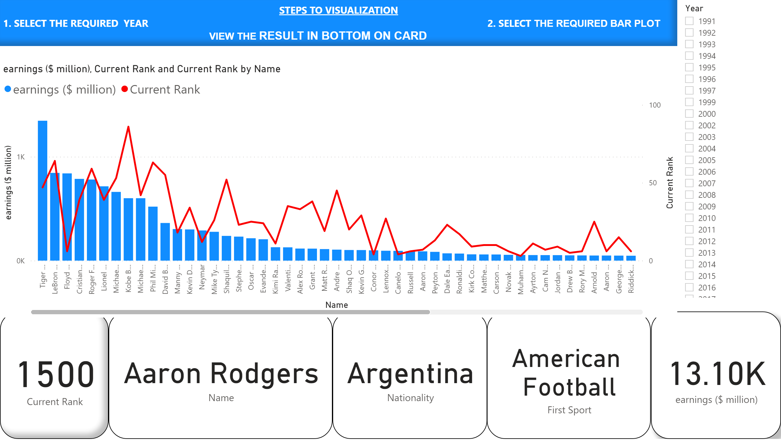
DETAIL EDA
Notes:
rrgrfd
No alt text provided.
card
No alt text provided.
card
No alt text provided.
card
No alt text provided.
card
No alt text provided.
lineStackedColumnComboChart
No alt text provided.
actionButton
No alt text provided.
slicer
No alt text provided.
textbox
No alt text provided.

Slide 3
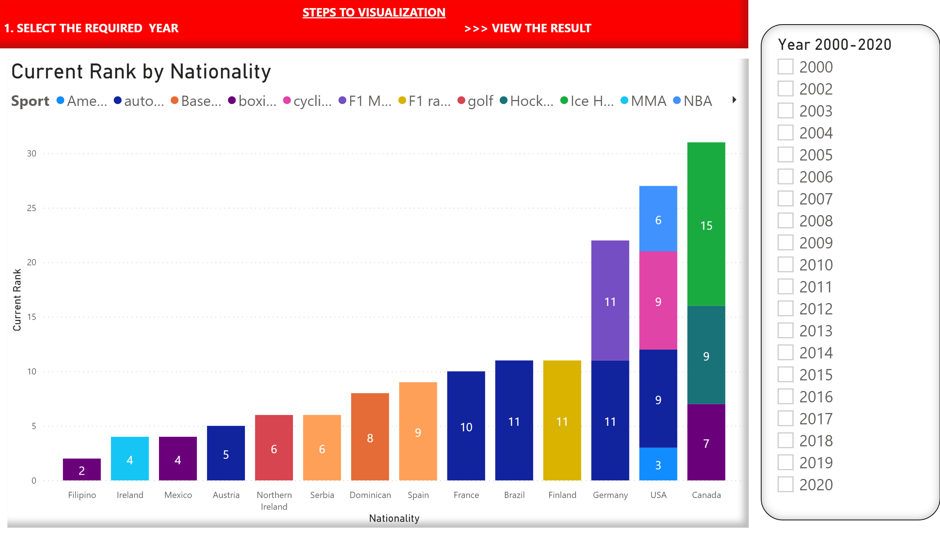
RANK BY NATIONALITY
Notes:
Current Rank by Nationality
No alt text provided.
slicer
No alt text provided.
textbox
No alt text provided.

Slide 4
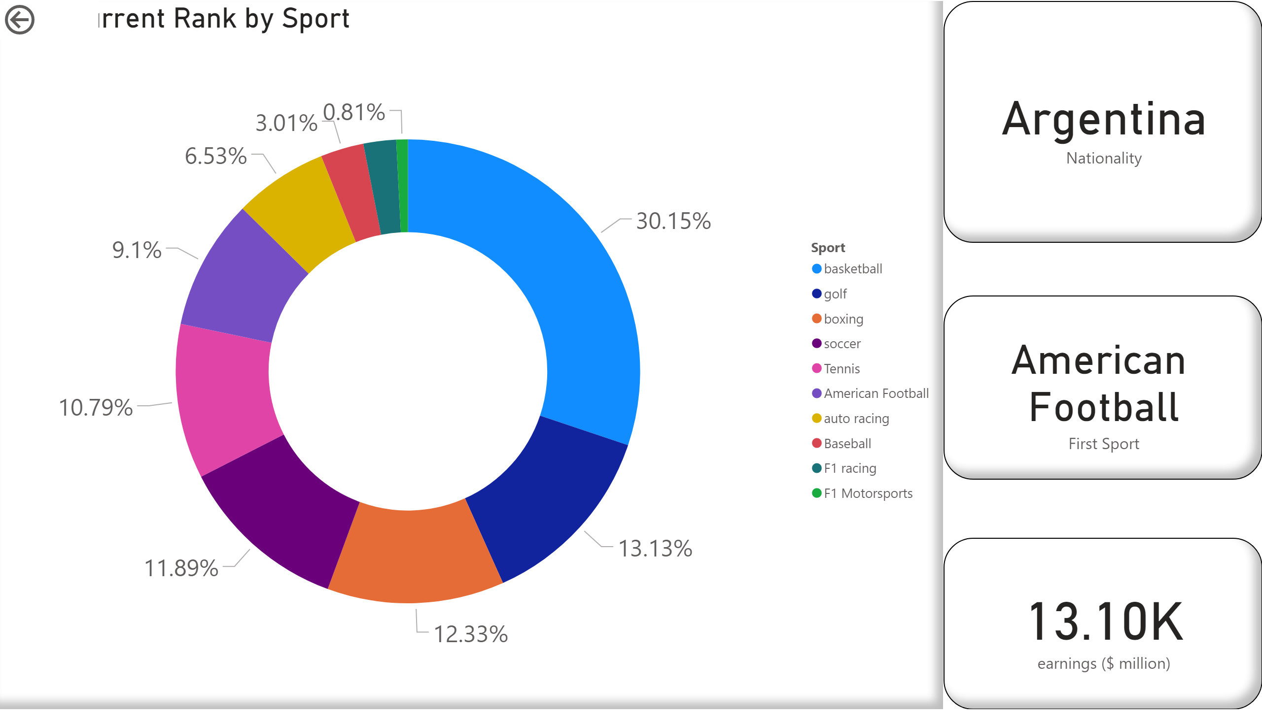
RANK IN % BY SPORT
Notes:
donutChart
No alt text provided.
card
No alt text provided.
card
No alt text provided.
card
No alt text provided.
actionButton
No alt text provided.

